Slide 1
Design Review #1
HyperLoop Computing
Ahmed, Sam and Travis

Slide 2
Requirements
System shall be able to establish link with remote access computer using SpaceX NAP.
System must successfully turn on and properly initialize all subsystems.
System shall begin startup sequence upon receiving start signal from communications processor/remote computer.
System shall be able to initialize and check state of each subsystem including:
Levitation System
Magnetic Braking
Disc Brakes
Propulsion
Power
Mag-Lev Arrays Manipulation
System shall be able to both raise and lower arrays.
System shall default arrays to safe position, in case of system failure.
Disc Brakes Application
System shall be able to effectively apply disc brakes.
System shall allow of integration of system developed by controls group for overall operation of disc brakes.
System shall apply brakes in the event of a system failure.
System shall be able to accurately receive and interpret sensor data.
System shall be able to determine state of vehicle.
System shall be able to determine if state is within safe working limits and shut down accordingly if needed.
System shall be able to accurately and precisely determine both speed and position of pod.
System shall remain stable at all times after turn on.
System shall maintain board temperature below 120° C
System shall be able to communicate between microprocessors of other subsystems and monitor their condition in real time.
System shall minimize its own power consumption.
System shall include fail safes in case of system failure.
System shall implement a STOP call from remote access computer.
System must allow for movability of pod at low speeds when not in operation to allow for transport and recovery exercises.

Slide 3
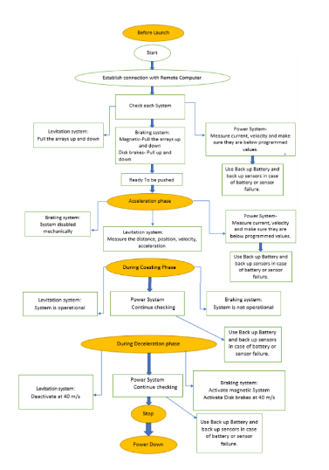
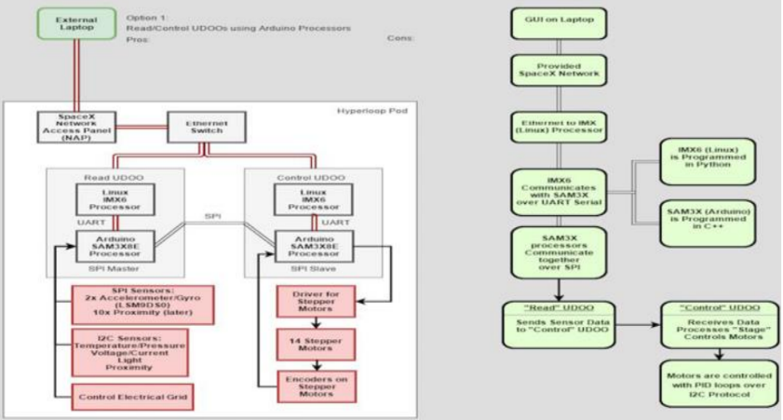
Conceptual Design

Slide 4
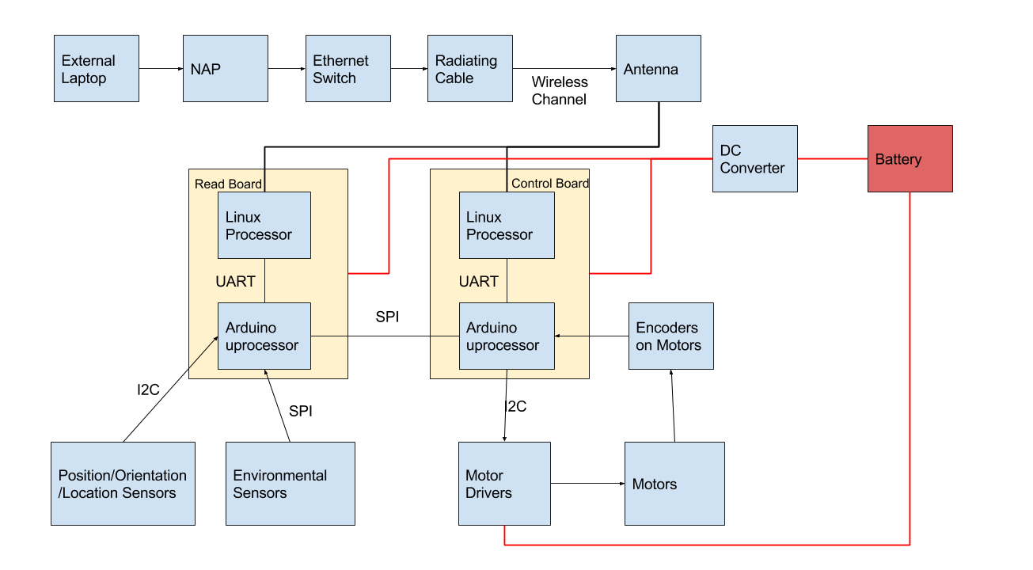

Slide 5
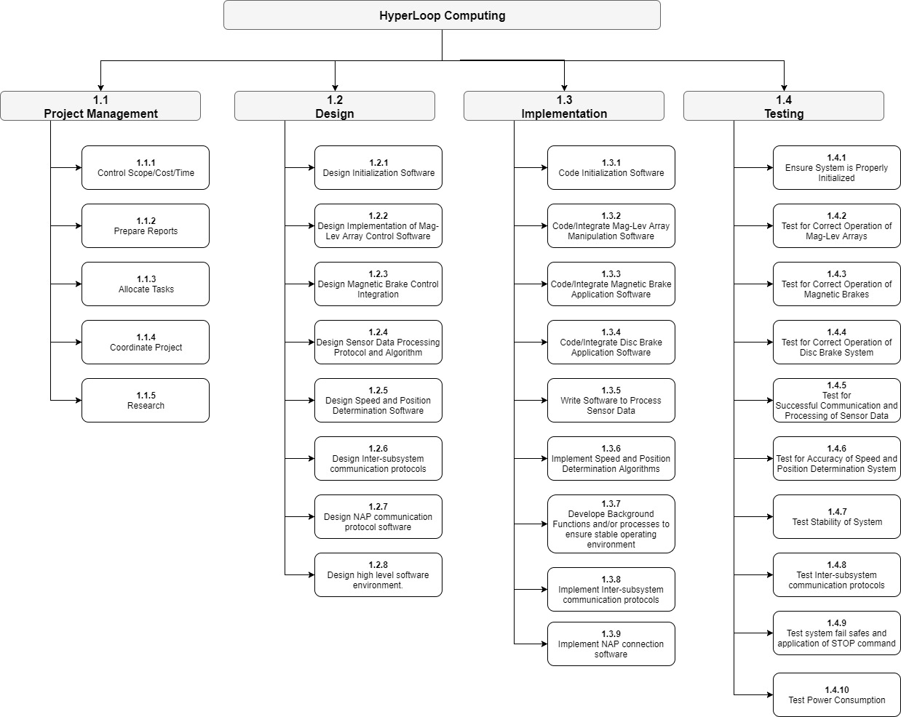
WBS

Slide 6
Rough Cost
Time
Predicted 60% in PM or ~216 hrs
~60 hrs in Control of Scope/Cost/Time
~35 hrs in Preparing Reports
~26 hrs in Task Allocations
~45 hrs in Coordination of Project
~50 hrs in Research
360 hours in project
Predicting 4 hours per person per week
14 Weeks in first Semester, 12 in Second before April, 4 weeks left for final testing
Two UDOO Quads: 2*$135 = $270
DC/DC Converter: (2)*$33 = $66
Total: $0 to ~$336
Depending on what ORU already has

Slide 7
Questions
Scope of our work
Choice of UDOO boards
Choice of serial protocols

